Slide 1
Continuous random variable

Slide 2
Some of continuous random variables in R
Some of the continuous distributions provided by R, together with the names of their parameter inputs.
Distribution | R name (dist) | Parameter names
Uniform | unif | min=0, max=1
Exponential | exp | rate=1
χ² | chisq | df
Gamma | gamma | shape, rate=1
Normal | norm | mean=0, sd=1
t | t | df
Weibull | weibull | shape, scale=1

Slide 3
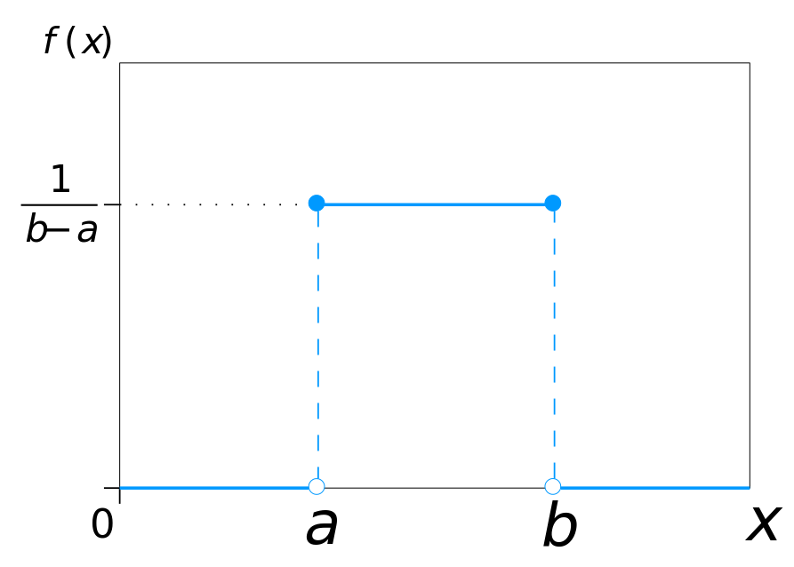
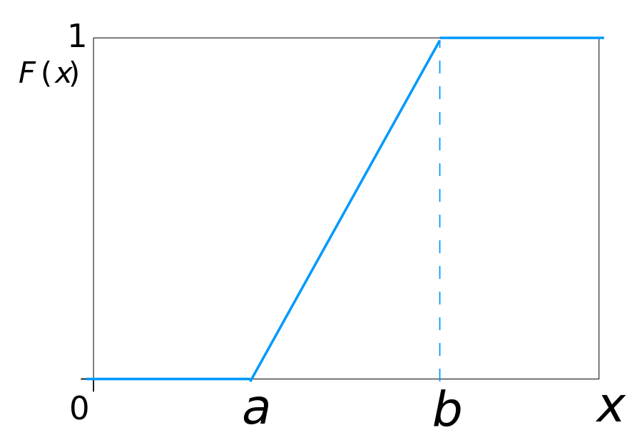
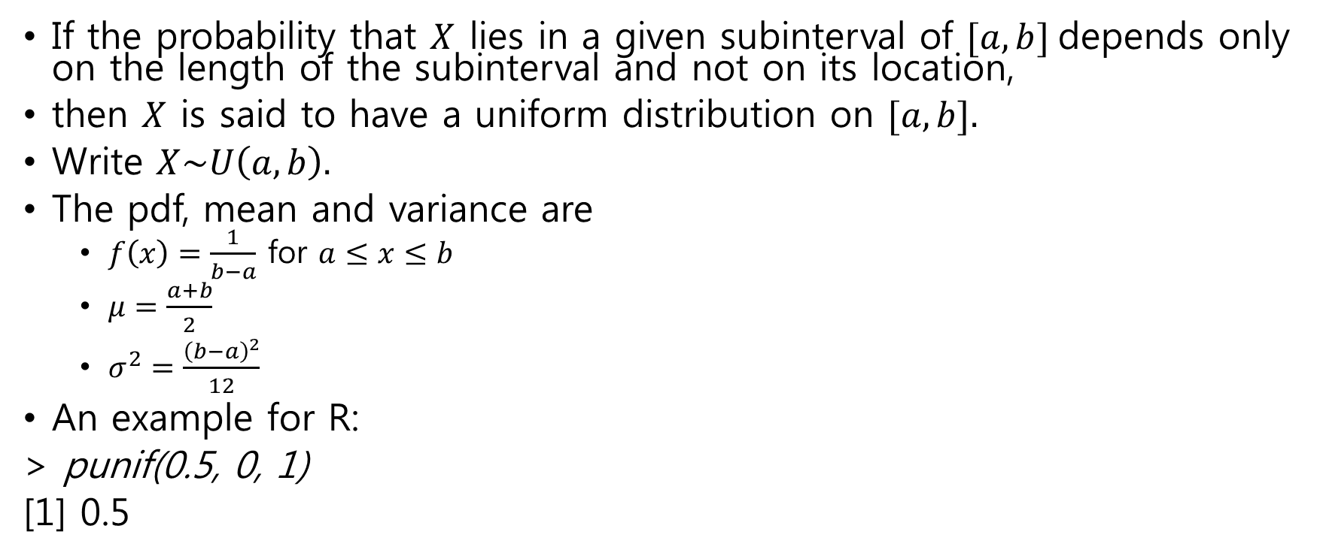
Uniform distribution
If the probability that $X$ lies in a given subinterval of $[a,b]$depends only on the length of the subinterval and not on its location,
then $X$ is said to have a uniform distribution on $[a,b].$
Write $X\sim U\left(a,b\right).$
The pdf, mean and variance are
$f\left(x\right)=\frac{1}{b−a}$ for $a≤x≤b$
$μ=\frac{a+b}{2}$
$σ^{2}=\frac{{\left(b−a\right)}^{2}}{12}$
An example for R:
> punif(0.5, 0, 1)
[1] 0.5

Slide 4
Uniform distribution in R
dunif(x, min=0, max=1, log = FALSE)
density function of the uniform on the interval from min to max.
punif(q, min=0, max=1, lower.tail = TRUE, log.p = FALSE)
the uniform distribution function
qunif(p, min=0, max=1, lower.tail = TRUE, log.p = FALSE)
quantile function
runif(n, min=0, max=1)
generate the uniform random variable
> var(runif(100000)) # approximately 1/12

Slide 5
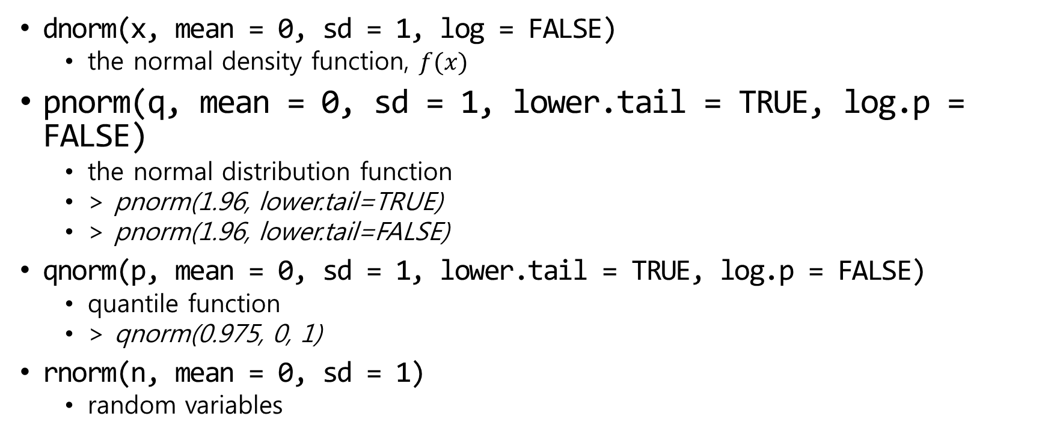
Normal distribution in R
dnorm(x, mean = 0, sd = 1, log = FALSE)
the normal density function, $f(x)$
pnorm(q, mean = 0, sd = 1, lower.tail = TRUE, log.p = FALSE)
the normal distribution function
> pnorm(1.96, lower.tail=TRUE)
> pnorm(1.96, lower.tail=FALSE)
qnorm(p, mean = 0, sd = 1, lower.tail = TRUE, log.p = FALSE)
quantile function
> qnorm(0.975, 0, 1)
rnorm(n, mean = 0, sd = 1)
random variables

Slide 6
Normal density with different mean
x <- seq(-3, 5, 0.01)
plot(x, dnorm(x, 0, 1), type="l", xlab="x", ylab="y", xlim=c(-3,5))
lines(x, dnorm(x, 1, 1), col="red")
lines(x, dnorm(x, 2, 1), col="blue")
title("Normal distribution: sigma=1, mu=0,1,2")

Slide 7
Normal density with different sigma
x <- seq(-10, 10, 0.01)
plot(x, dnorm(x, 0, 1), type="l", xlab="x", ylab="y", xlim=c(-10,10))
lines(x, dnorm(x, 0, 2), col="red")
lines(x, dnorm(x, 0, 3), col="blue")
title("Normal distribution: mu=0, sigma=1,2,3")

Slide 8
Normal random variable
z<-rnorm(10000) par(las=1) hist(z, breaks = seq(-5,5,0.2), freq=F) phi <- function(x) exp(-x^2/2)/sqrt(2*pi) x <- seq(-5,5,0.1) lines(x, phi(x))

Slide 9
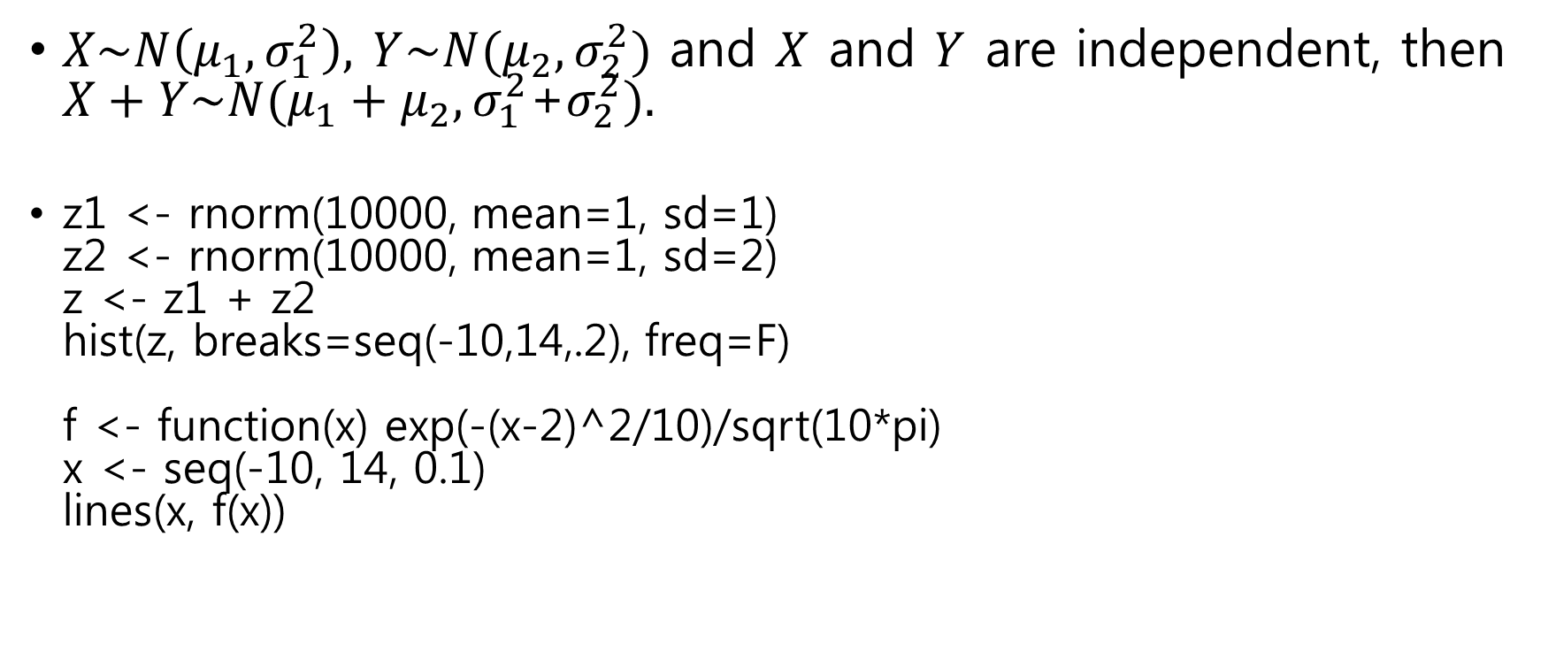
Sum of independent normal
$X\sim N\left(μ_{1},σ_{1}^{2}\right),$ $Y\sim N(μ_{2},σ_{2}^{2})$ and $X$ and $Y$ are independent, then $X+Y\sim N(μ_{1}+μ_{2}, σ_{1}^{2}$+$σ_{2}^{2}).$
z1 <- rnorm(10000, mean=1, sd=1) z2 <- rnorm(10000, mean=1, sd=2) z <- z1 + z2 hist(z, breaks=seq(-10,14,.2), freq=F) f <- function(x) exp(-(x-2)^2/10)/sqrt(10*pi) x <- seq(-10, 14, 0.1) lines(x, f(x))

Slide 10
Correlated normal r.v.s
Z1 <- rnorm(1000)
Z2 <- rnorm(1000)
par(mfrow=c(1,3))
rhos <- c(-0.7,0,0.7)
for (rho in rhos){
X <- Z1
Y <- rho*Z1 + sqrt(1-rho^2)*Z2
plot(X,Y)
title(paste("rho = ", rho))
show(var(X+Y))
}

Slide 11
Correlated normal r.v.s (2)

Slide 12
t-density
curve(dt(x, df=1), from=-6, to=6, ylab="density", ylim=c(0,0.4))
curve(dt(x, df=2), add = TRUE)
curve(dt(x, df=4), add = TRUE)
curve(dt(x, df=10), add = TRUE)
curve(dnorm(x), lwd=2, add= TRUE)
title("t densities with 1,2,4 and 10 d.f., and normal limit in bold")

Slide 13
chi-square density
curve(dchisq(x, df=1), from=0, to=8, ylab="density", ylim=c(0,0.5))
curve(dchisq(x, df=2), col="red", add = TRUE)
curve(dchisq(x, df=3), col="blue", add = TRUE)
curve(dchisq(x, df=4), col="darkgreen", add = TRUE)
legend("topright", c("df=1", "df=2", "df=3", "df=4"), pch="----", col=c("black","red","blue","darkgreen"))

Slide 14
Chi-square simulation
dfs <- c(1,2,3,4)
N <- 1000
par(mfrow=c(2,2))
for (df in dfs){
chi_rv <- numeric(N)
for (i in 1:df)
chi_rv <- chi_rv + rnorm(N)^2
hist(chi_rv, breaks=seq(0, 30, 0.5), freq=F, main=paste("d.f. = ", df))
curve(dchisq(x, df), add=T)
}

Slide 15
Chi-square simulation(2)

Slide 16
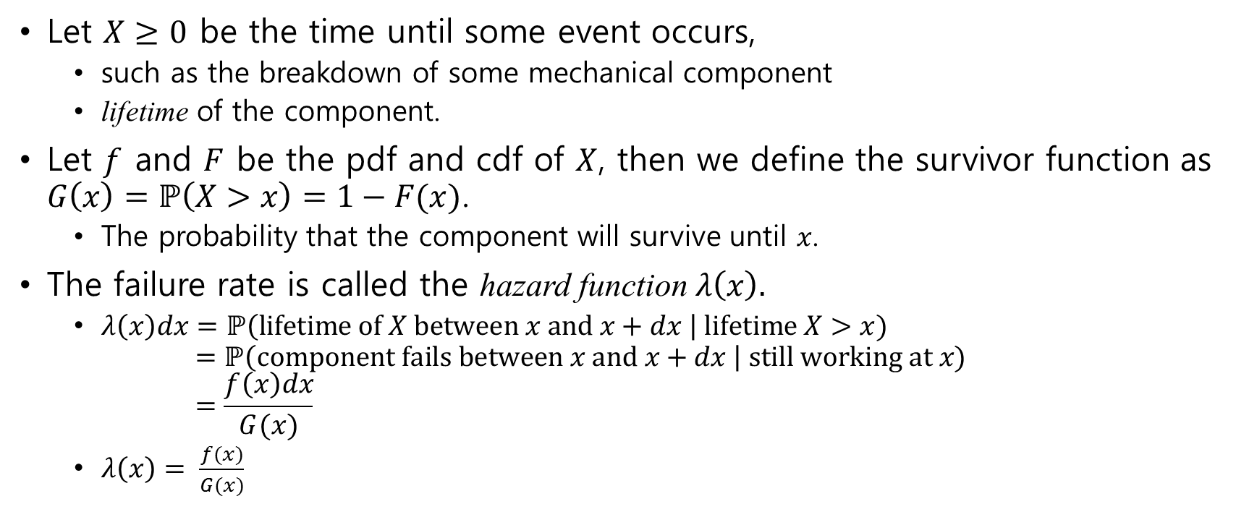
Lifetime models : exponential and Weibull
Let $X≥0$ be the time until some event occurs,
such as the breakdown of some mechanical component
lifetime of the component.
Let $f$ and $F$ be the pdf and cdf of $X$, then we define the survivor function as $G\left(x\right)=\text{ℙ}\left(X>x\right)=1−F(x)$.
The probability that the component will survive until $x$.
The failure rate is called the hazard function $λ\left(x\right).$
$λ\left(x\right)dx=\text{ℙ}\left(lifetime of X between x and x+dx \right| lifetime X>x)$ $=\text{ℙ}\left(component fails between x and x+dx \right| still working at x)$ $=\frac{f\left(x\right)dx}{G(x)}$
$λ\left(x\right)= \frac{f(x)}{G(x)}$

Slide 17

Lifetime models (2)
We can find the density $f$ from $λ$ as follows: $f\left(x\right)= \frac{d F(x)}{dx}=\frac{d}{dx}\left(1−G\left(x\right)\right)=−\frac{dG\left(x\right)}{dx}$ $λ\left(x\right)= \frac{f(x)}{G(x)}=\frac{−G′(x)}{G(x)}=−\frac{d}{dx}\log{G\left(x\right)}$ $G\left(x\right)=\exp\left(−\int_{0}^{x}{λ\left(u\right)du}\right)$ $f\left(x\right)=λ\left(x\right)\exp\left(−\int_{0}^{x}{λ\left(u\right)du}\right)$

Slide 18
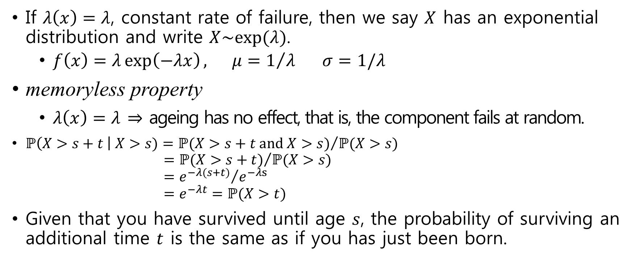
Exponential distribution
If $λ\left(x\right)=λ$, constant rate of failure, then we say $X$ has an exponential distribution and write $X\sim exp⁡(λ)$.
$f\left(x\right)=λ\exp\left(−λx\right), μ=1/λ σ=1/λ$
memoryless property
$λ\left(x\right)=λ$ $⇒$ ageing has no effect, that is, the component fails at random.
$\text{ℙ}\left(X>s+t \right| X>s)={\text{ℙ}(X>s+t and X>s)}/{\text{ℙ}(X>s)}$ $={\text{ℙ}(X>s+t)}/{\text{ℙ}(X>s)}$ $={e^{−λ(s+t)}}/{e^{−λs}}$ $=e^{−λt}=\text{ℙ}(X>t)$
Given that you have survived until age $s$, the probability of surviving an additional time $t$ is the same as if you has just been born.

Slide 19
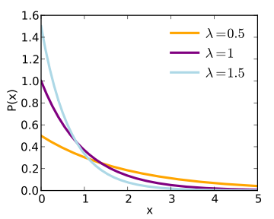
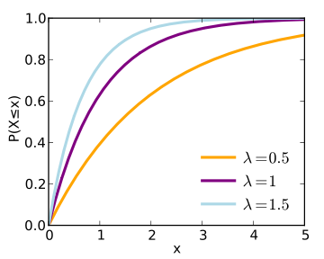
Exponential distribution(2)
density function
distribution function

Slide 20
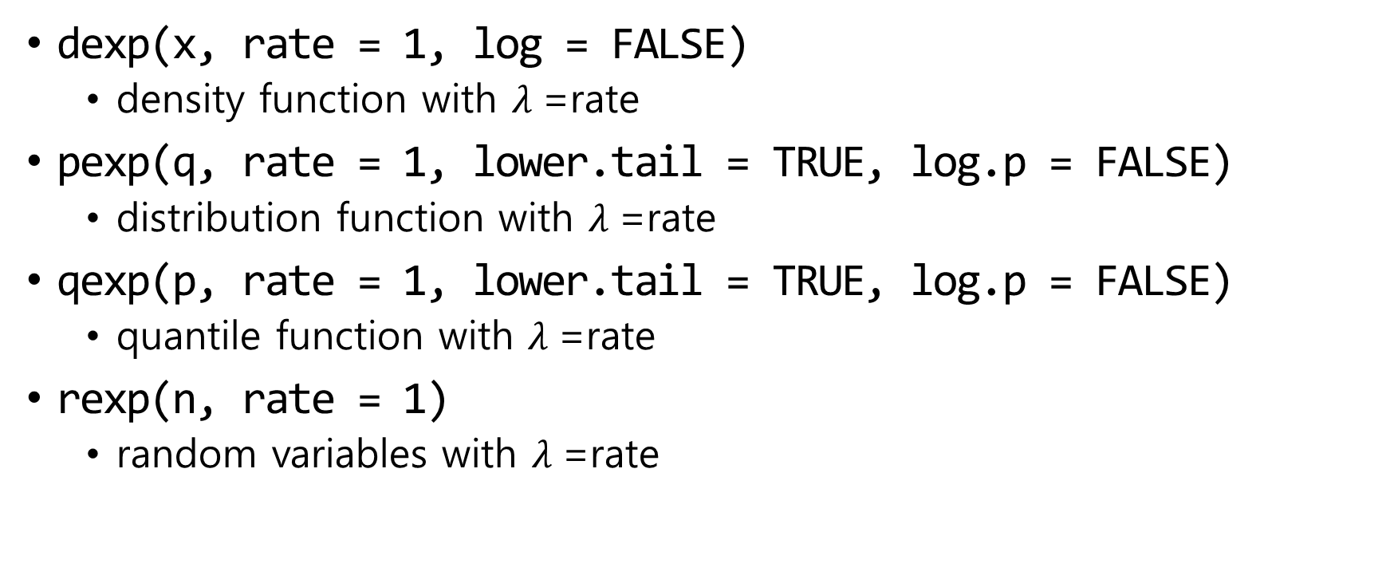
Exponential distribution in R
dexp(x, rate = 1, log = FALSE)
density function with $λ$=rate
pexp(q, rate = 1, lower.tail = TRUE, log.p = FALSE)
distribution function with $λ$=rate
qexp(p, rate = 1, lower.tail = TRUE, log.p = FALSE)
quantile function with $λ$=rate
rexp(n, rate = 1)
random variables with $λ$=rate

Slide 21
Exponential density
x = seq(0,8,0.01)
plot(x, dexp(x, rate=2), type="l", ylab="f(x)")
lines(x, dexp(x, rate=1) , col="red")
lines(x, dexp(x, rate=0.5), col="blue")

Slide 22
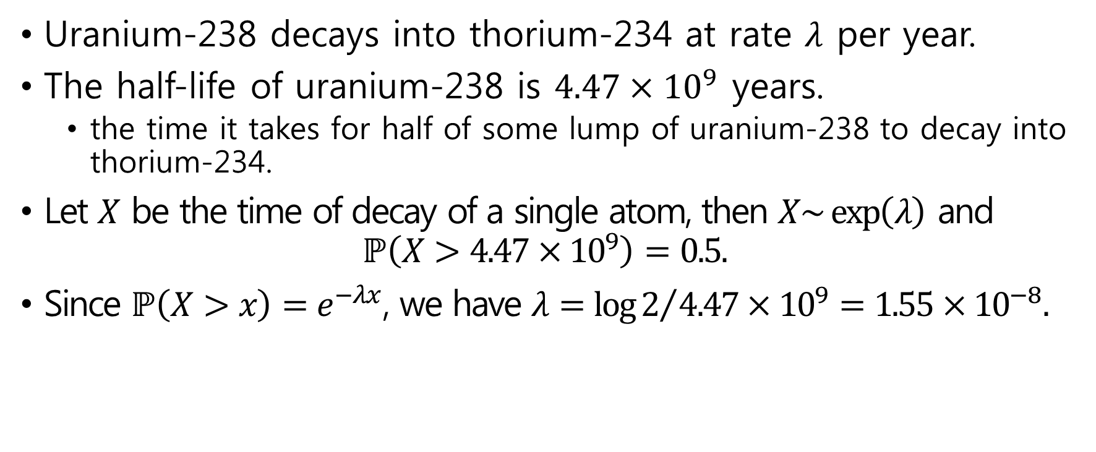
Example : radioactive decay
Uranium-238 decays into thorium-234 at rate $λ$ per year.
The half-life of uranium-238 is $4.47×{10}^{9}$ years.
the time it takes for half of some lump of uranium-238 to decay into thorium-234.
Let $X$ be the time of decay of a single atom, then $X\sim \exp\left(λ\right)$ and $\text{ℙ}\left(X>4.47×{10}^{9}\right)=0.5.$
Since $\text{ℙ}\left(X>x\right)=e^{−λx}$, we have $λ={\log{2}}/{4.47×{10}^{9}}=1.55×{10}^{−8}.$

Slide 23
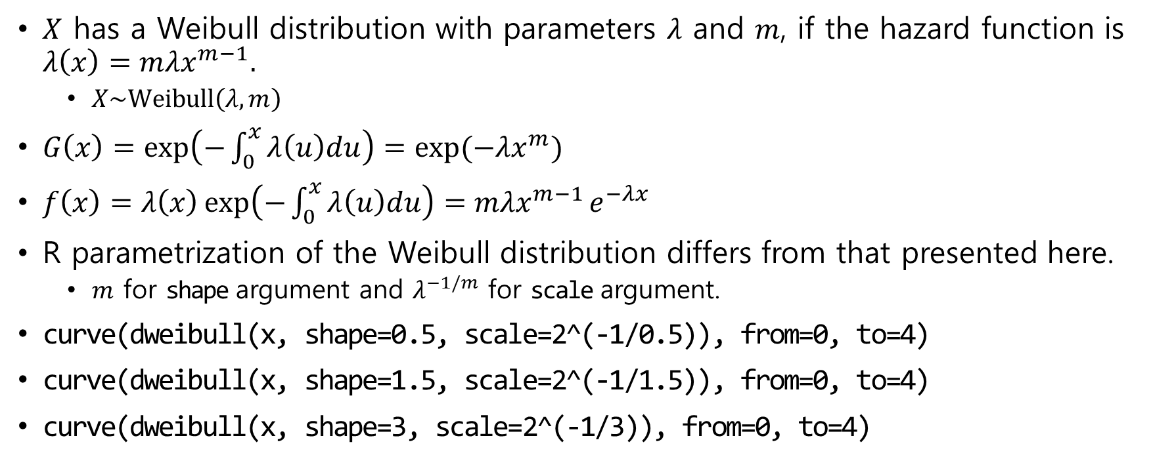
Weibull distribution
$X$ has a Weibull distribution with parameters $λ$ and $m$, if the hazard function is $λ\left(x\right)=mλx^{m−1}.$
$X\sim \text{Weibull}\left(λ,m\right)$
$G\left(x\right)=\exp\left(−\int_{0}^{x}{λ\left(u\right)du}\right)=exp⁡(−λx^{m})$
$f\left(x\right)=λ\left(x\right)\exp\left(−\int_{0}^{x}{λ\left(u\right)du}\right)=mλx^{m−1}e^{−λx}$
R parametrization of the Weibull distribution differs from that presented here.
$m$ for shape argument and $λ^{−1/m}$ for scale argument.
curve(dweibull(x, shape=0.5, scale=2^(-1/0.5)), from=0, to=4)
curve(dweibull(x, shape=1.5, scale=2^(-1/1.5)), from=0, to=4)
curve(dweibull(x, shape=3, scale=2^(-1/3)), from=0, to=4)

Slide 24
Weibull density

Slide 25
Weibull density(2)
x=seq(0,4,0.001)
curve(2*x, from=0, to=4, ylab="hazard function")
lines(x, 2.5*x^(1.5))
lines(x, 0.5*x^(-0.5))
lines(x, 1.5*x^0.5)
lines(x, rep(1,length(x)))
text(2.3, 6.99, "m>2")
text(3, 5.2, "m=2")
text(2.5, 2.65, "1<m<2")
text(3.5, 1.3, "m=1")
text(3, 0.52, "m<1")
par(mfrow=c(3,1))
curve(dweibull(x, shape=0.5, scale=2^(-1/0.5)), from=0, to=4, ylab="f(x)", lwd=3)
text(2,2,"Weibull(2,0.5) density")
curve(dweibull(x, shape=1.5, scale=2^(-1/1.5)), from=0, to=4, ylab="f(x)", lwd=3)
text(2,0.6,"Weibull(2,1.5) density")
curve(dweibull(x, shape=3, scale=2^(-1/3)), from=0, to=4, ylab="f(x)", lwd=3)
text(2,0.8,"Weibull(2,3) density")

Slide 26
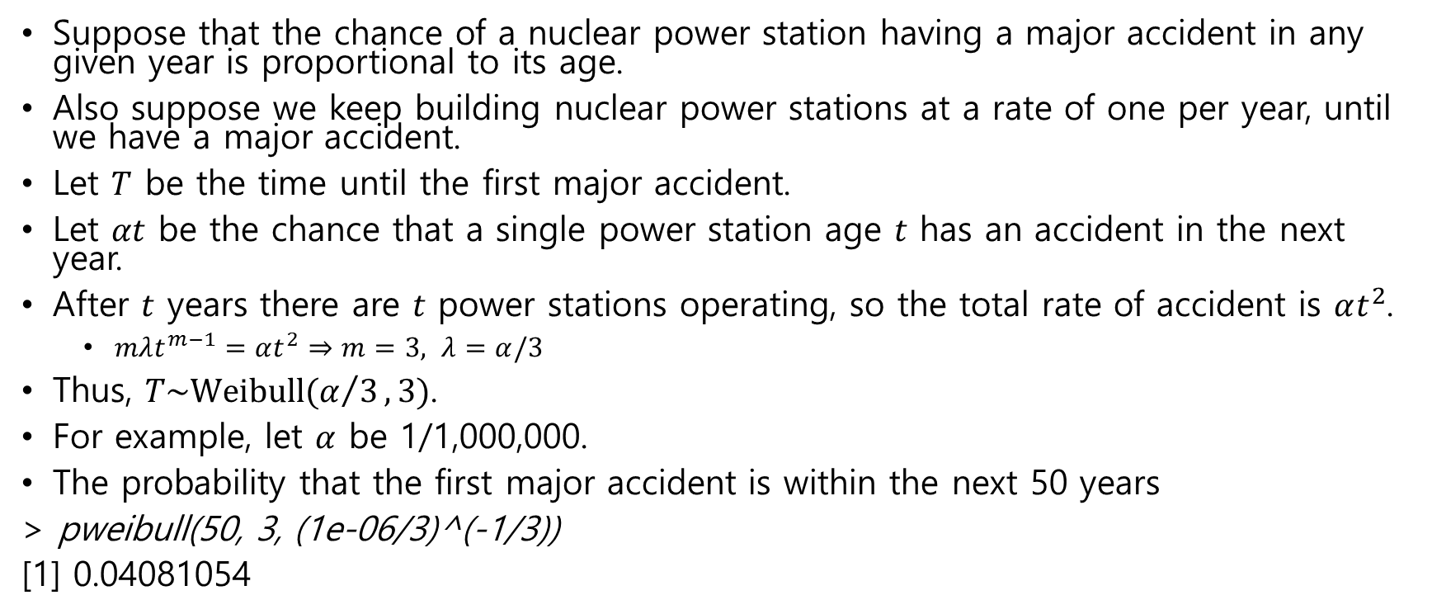
Example : time to the next disaster
Suppose that the chance of a nuclear power station having a major accident in any given year is proportional to its age.
Also suppose we keep building nuclear power stations at a rate of one per year, until we have a major accident.
Let $T$ be the time until the first major accident.
Let $αt$ be the chance that a single power station age $t$ has an accident in the next year.
After $t$ years there are $t$ power stations operating, so the total rate of accident is $αt^{2}$.
$mλt^{m−1}=αt^{2}⇒m=3, λ=α/3$
Thus, $T\sim \text{Weibull}(α/3,3)$.
For example, let $α$ be 1/1,000,000.
The probability that the first major accident is within the next 50 years
> pweibull(50, 3, (1e-06/3)^(-1/3))
[1] 0.04081054

Slide 27
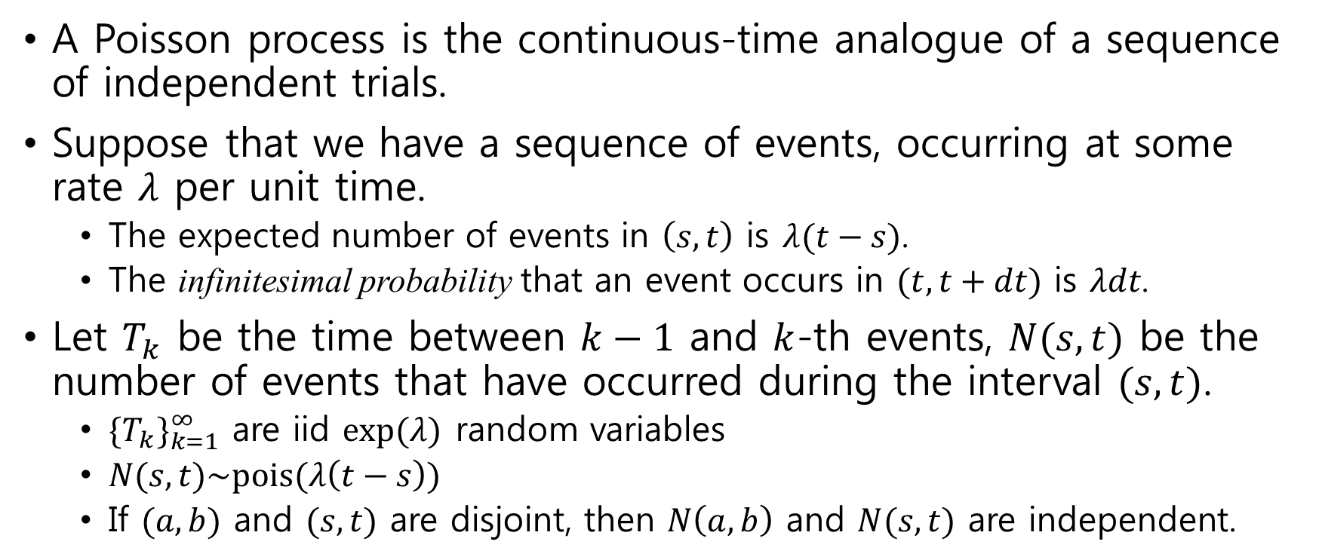
Poisson process
A Poisson process is the continuous-time analogue of a sequence of independent trials.
Suppose that we have a sequence of events, occurring at some rate $λ$ per unit time.
The expected number of events in $\left(s,t\right)$ is $λ(t−s)$.
The infinitesimal probability that an event occurs in $(t,t+dt)$ is $λdt$.
Let $T_{k}$ be the time between $k−1$ and $k$-th events, $N(s,t)$ be the number of events that have occurred during the interval $(s,t)$.
${\{T_{k}\}}_{k=1}^{∞}$ are iid $exp⁡(λ)$ random variables
$N(s,t)\sim \text{pois}(λ\left(t−s\right))$
If $(a,b)$ and $(s,t)$ are disjoint, then $N\left(a, b\right)$ and $N(s,t)$ are independent.

Slide 28
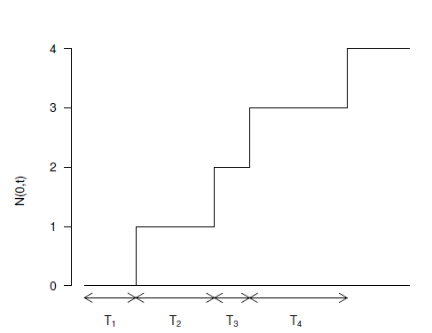
Poisson process
A Poisson process looks like

Slide 29
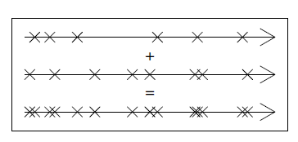
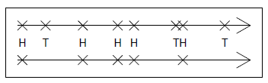
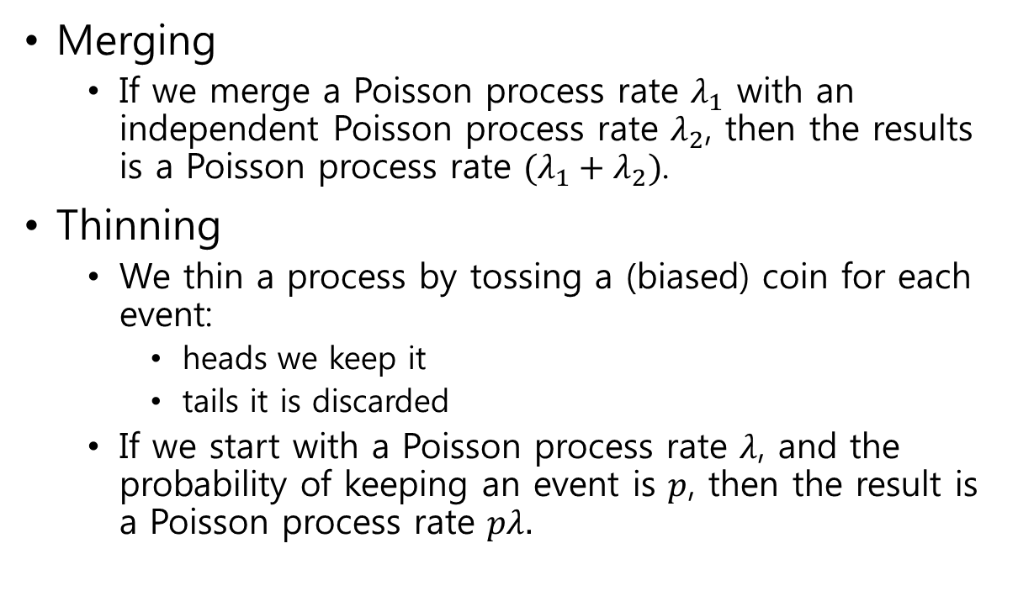
Merging and Thinning
Merging
If we merge a Poisson process rate $λ_{1}$ with an independent Poisson process rate $λ_{2}$, then the results is a Poisson process rate $(λ_{1}+λ_{2})$.
Thinning
We thin a process by tossing a (biased) coin for each event:
heads we keep it
tails it is discarded
If we start with a Poisson process rate $λ$, and the probability of keeping an event is $p$, then the result is a Poisson process rate $pλ.$

Slide 30
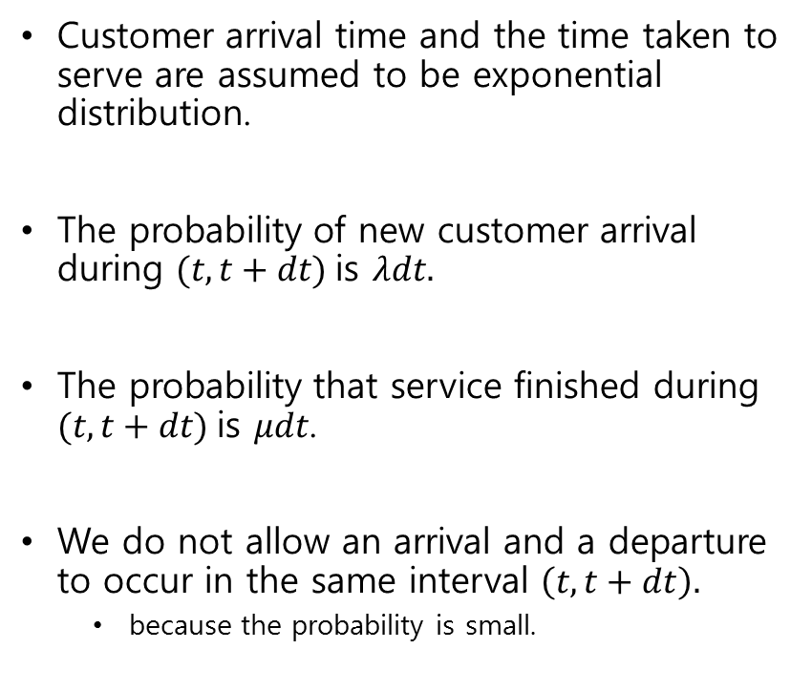
Queuing simulation
Customer arrival time and the time taken to serve are assumed to be exponential distribution.
The probability of new customer arrival during $(t, t+dt)$is $λdt.$
The probability that service finished during $(t, t+dt)$is $μdt$.
We do not allow an arrival and a departure to occur in the same interval $\left(t, t+dt\right).$
because the probability is small.
lambda <- 1 # arrival rate mu <- 1.1 # service rate t.end <- 100 # duration of simulation t.step <- 0.05 # time step queue <- rep(0, t.end/t.step + 1) for (i in 2:length(queue)) { if (runif(1) < lambda*t.step) { # arrival queue[i] <- queue[i-1] + 1 } else if (runif(1) < mu*t.step) { # departure queue[i] <- max(0, queue[i-1] - 1) } else { # nothing happens queue[i] <- queue[i-1] } }

Slide 31
Queuing simulation(2)
plot(seq(0, t.end, t.step), queue, type='l', xlab='time', ylab='queue size') title(paste('Queuing Simulation. Arrival rate:', lambda,'Service rate:', mu))

